Slide 1
MARKET BASKET INSIGHTS phase 1 project:

Slide 2
Introduction:
Market basket insights, in simple words, refer to understanding what items people tend to buy together when they go shopping. It's like noticing that many customers who buy bread also buy butter, so you might want to place these items close to each other in a store. This analysis helps businesses make smarter decisions about product placement, marketing, and promotions to increase sales and improve the shopping experience
A market basket analysis is a set of affinity calculations meant to determine which items sell together. For example, a grocery store may use market basket analysis to determine that consumers typically buy both hot dogs and hot dog buns together

Slide 3
Flow of analysis:
Data Source
Data Preprocessing
Association Analysis
Insights Generation
Visualization
Business Recommendations

Slide 4
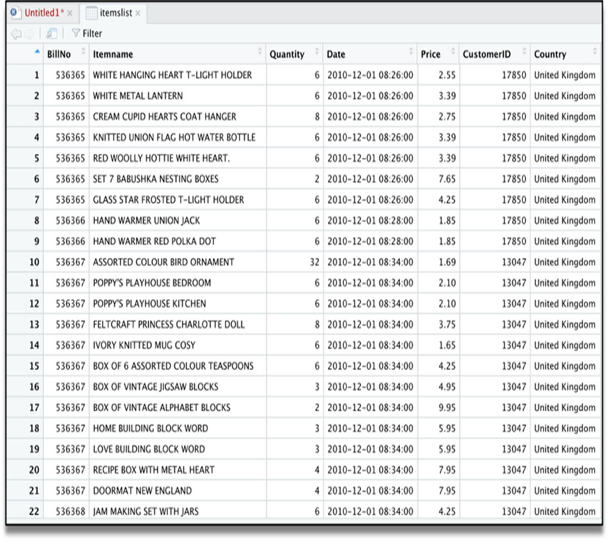
Data source :

Slide 5
Data preprocessing
Apriori Algorithm:
Apriori algorithm refers to an algorithm that is used in mining frequent products sets and relevant association rules. Generally, the apriori algorithm operates on a database containing a huge number of transactions. For example, the items customers but at a Big Bazar.
Components of Apriori algorithm
The given three components comprise the apriori algorithm.
Support
Confidence
Lift.

Slide 6
Market Basket Analysis
Step 1:Analysis the data set.
Assume there are 100 customers, 10 of them bought Computer Mouth, 9 bought Mat for Mouse and 8 bought both of them.
bought Computer Mouth => bought Mat for Mouse
support = P(Mouth & Mat) = 8/100 = 0.08
confidence = support/P(Mat for Mouse) = 0.08/0.09 = 0.89
lift = confidence/P(Computer Mouth) = 0.89/0.10 = 8.9
This just simple example. In practice, a rule needs the support of several hundred transactions, before it can be considered statistically significant, and datasets often contain thousands or millions of transactions.

Slide 7
Step 1:
Product | Frequency (Number of transactions)
Rice (R) | 4
Pulse(P) | 5
Oil(O) | 4
Milk(M) | 4
Make a frequency table of all the products that appear in all the transactions. Now, short the frequency table to add only those products with a threshold support level of over 50 percent. We find the given frequency table.

Slide 8
Step 2:
Itemset | Frequency (Number of transactions)
RP | 4
RO | 3
RM | 2
PO | 4
PM | 3
Create pairs of products such as RP, RO, RM, PO, PM, OM. You will get the given frequency table.

Slide 9
Step 3 :
Implementing the same threshold support of 50 percent and consider the products that are more than 50 percent. In our case, it is more than 3
Thus, we get RP, RO, PO, and PM.
Step 4:
Now, look for a set of three products that the customers buy together. We get the given combination.
RP and RO give RPO
PO and PM give POM

Slide 10
Step 5:
Itemset | Frequency (Number of transactions)
RPO | 4
POM | 3
Calculate the frequency of the two item sets, and you will get the given frequency table.

Slide 11
Insights generation :
Cross-selling: Retailers can use market basket analysis to identify products frequently bought together. This information can be used for cross-selling, where related products are strategically placed together to encourage customers to buy more.
Inventory Management: Understanding item associations can help with inventory management. For instance, if two items are often purchased together, it might make sense to stock them near each other to save time for customers.
Planning: Retailers can use this analysis to design promotions and discounts. For example, offering a discount on one product if another related product is purchased can drive sales.
Personalization: E-commerce websites use market basket analysis to provide personalized product recommendations to customers based on their browsing and purchasing history.Store Layout
Optimization: In physical stores, insights from market basket analysis can inform the layout. Items that are frequently bought together can be placed closer to each other, increasing the chances of additional sales.
Customer Segmentation: By analyzing market baskets, businesses can segment customers based on their buying habits. This can lead to more targeted marketing and product chain processes.

Slide 12
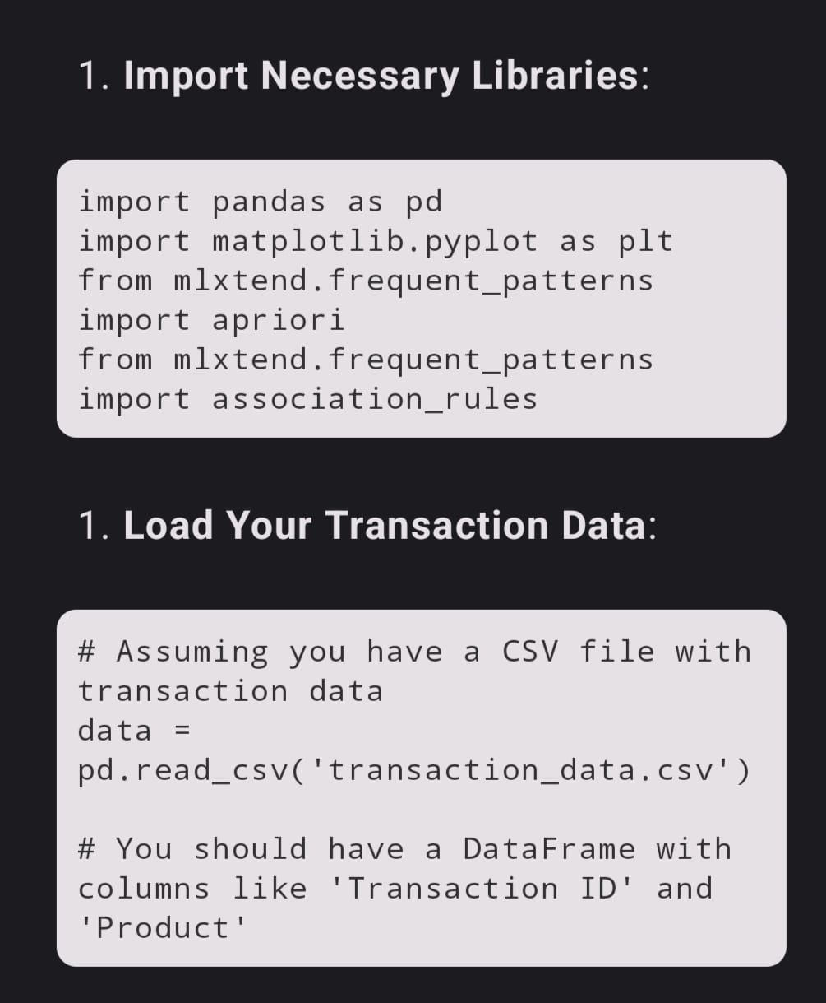
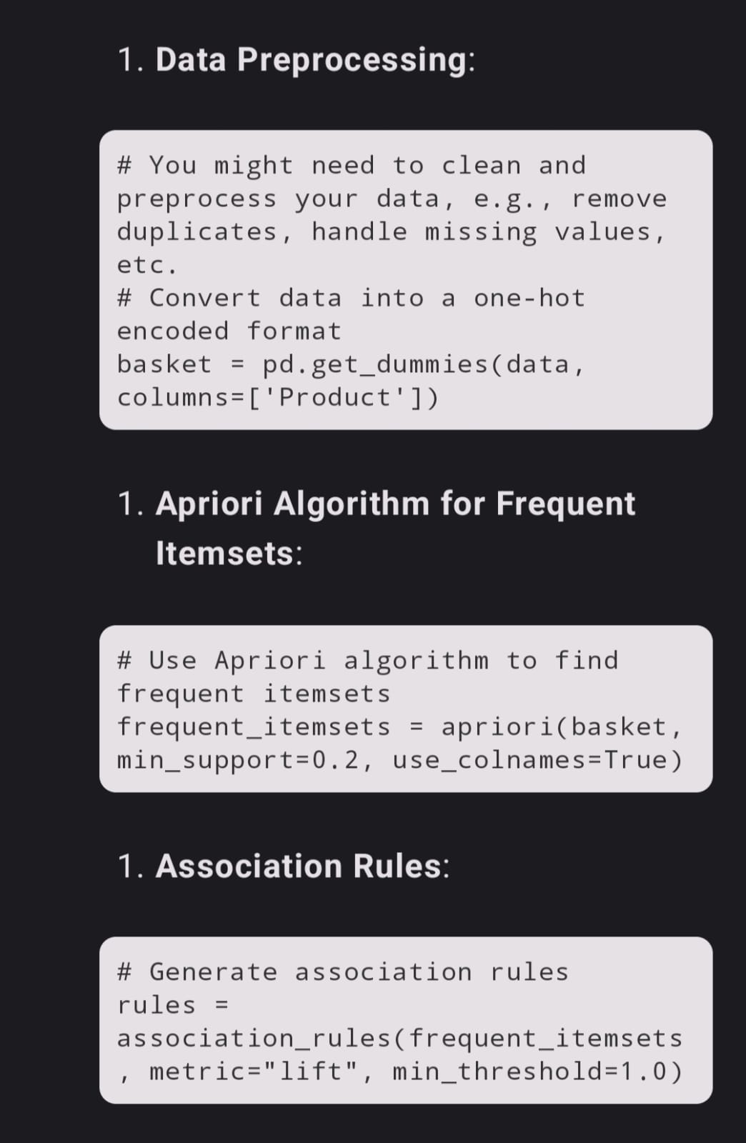
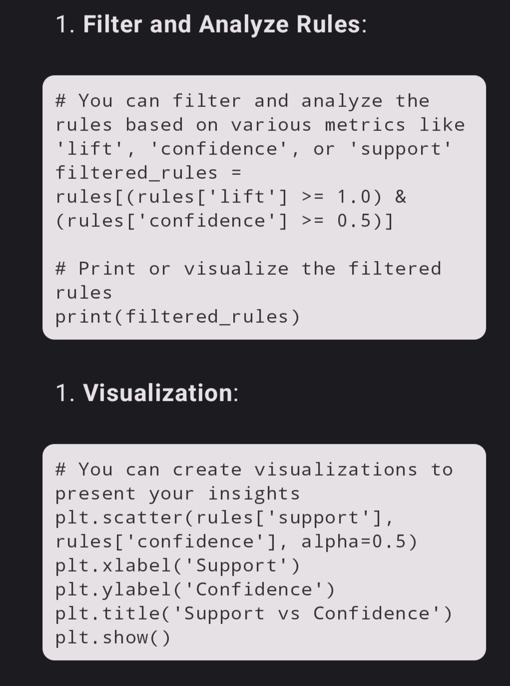
coding:

Slide 13
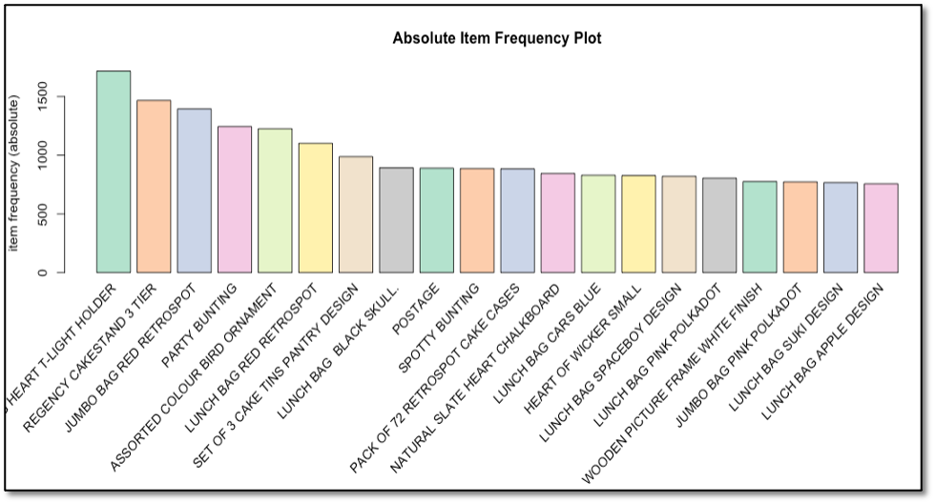
visualization:

Slide 14
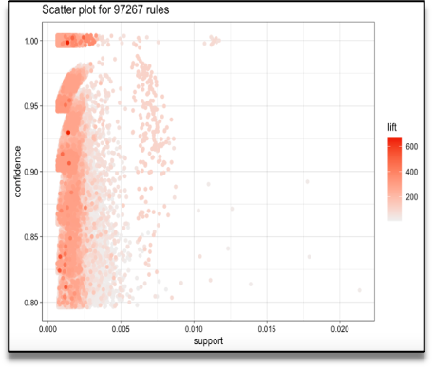
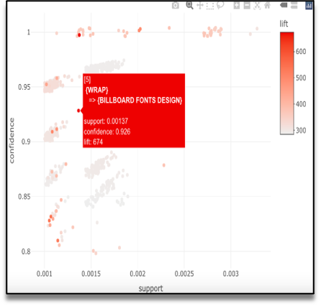

Slide 15
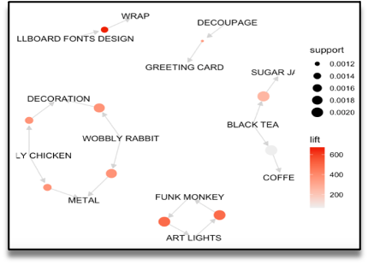
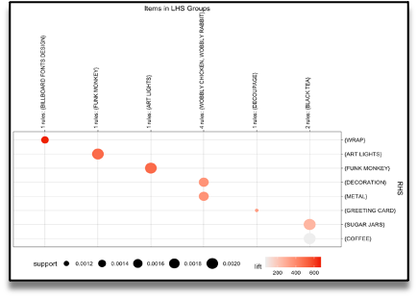

Slide 16
Busniess recommendations
Pricing and Discount Strategies:
  Bundling: Bundle frequently co-purchased products together at a discounted price. This can encourage customers to buy more items, increasing the average transaction value.
  Volume Discounts: Offer discounts on specific items or categories when customers buy in bulk. Market basket insights can help identify which products are often bought in large quantities.
Inventory Management:
  Stocking Strategy: Ensure that frequently co-purchased products are stocked near each other in physical stores. This can improve the shopping experience and encourage cross-selling.
  Inventory Optimization: Use market basket insights to optimize inventory levels. Stock more of the items

Slide 17
conclusion:
Based on the results of these calculations can be used as a recommendation for retail owners to arrange the arrangement of product catalogs and take strategic steps to improve product marketing.. By utilizing the association rules which are discovered as a result of the analyses, the retailer can apply effective marketing and sales promotion strategies, he will be able increase customer engagement and improve customer experience and identify customer behavior.

Slide 18
thank you

